Slide 1
Inheritance

Slide 2
Inheritance is a fundamental Object Oriented concept
A class can be defined as a "subclass" of another class.
The subclass inherits all data attributes of its superclass
The subclass inherits all methods of its superclass
The subclass inherits all associations of its superclass
The subclass can:
Add new functionality
Use inherited functionality
Override inherited functionality

Slide 3
Person
- name: String
- dob: Date
Super class
Is a
Employee
- employeeID: int
- salary: int
- startDate: Date
Sub class

Slide 4
When an object is created using new, the system must allocate enough memory to hold all its instance variables.
This includes any inherited instance variables
In this example, we can say that an Employee "is a kind of" Person.
An Employee object inherits all of the attributes, methods and associations of Person

Slide 5
Inheritance is declared using the "extends" keyword
If inheritance is not defined, the class extends a class called Object
Class subclassname extends superclassname
{
Variable declaration;
Method declaration;
}

Slide 6
public class Person
{
private String name;
private Date dob;
[...]
public class Employee extends Person
{
private int employeID;
private int salary;
private Date startDate;
[...]
Employee anEmployee = new Employee();

Slide 7
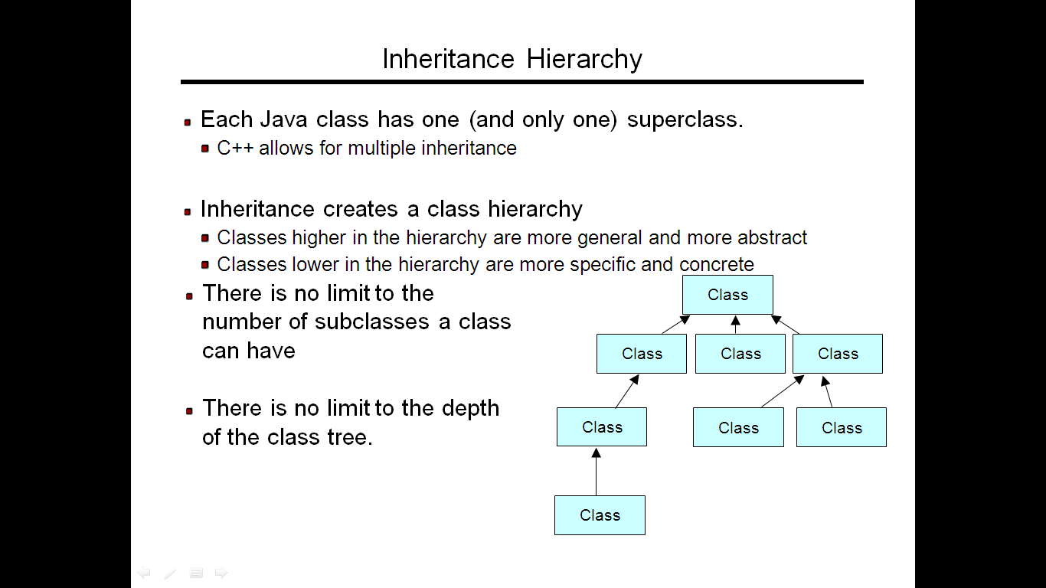

Slide 8
Types
Single inheritance
Multilevel inheritance
Multiple inheritance(interfacing)
Hierarchical inheritance

Slide 9
Program of single inheritance
class room
{
int length,bredth;
room(int x,int y)
{
length=x;
bredth=y;
}
int area()
{
return(length*bredth);
}
}

Slide 10
class room2 extends room //inheriting room
{
int height;
room2(int x,int y,int z)
{
super(x,y); //pass value to super class
height=z;
}
int volume()
{
return(length*bredth*height);
}
}

Slide 11
class inher
{
public static void main(String args[])
{
room2 r=new room2(14,12,10);
int area1=r.area();
int volume1=r.volume();
System.out.println(+area1);
System.out.println(+volume1);
}
}

Slide 12
INTERFACES:MULTIPLE INHERITANCE
Class classname implements interface name
{
}
Class classname extends classname implements interface
{
}

Slide 13
class student
{
int rollno;
void getnumber(int n)
{
rollno=n;
}
void putnumber()
{
System.out.println("rollno:"+rollno);
}
}

Slide 14
class test extends student
{
float part1,part2;
void getmarks(float m1,float m2)
{
part1=m1;
part2=m2;
}
void putmarks()
{
System.out.println("marks obtained");
System.out.println("part1:"+part1);
System.out.println("part2:"+part2);
}
}

Slide 15
interface sports
{
float sportswt=6.0F;
void putwt();
}

Slide 16
class results extends test implements sports
{
float total;
public void putwt()
{
System.out.println("sportswt:"+sportswt);
}
void display()
{
total=part1+part2+sportswt;
putnumber();
putmarks();
putwt();
System.out.println("total score"+total);
}
}

Slide 17
class hybrid
{
public static void main(String args[])
{
results s1=new results();
s1.getnumber(1234);
s1.getmarks(27.5F,33.0F);
s1.display();
}
}

Slide 18
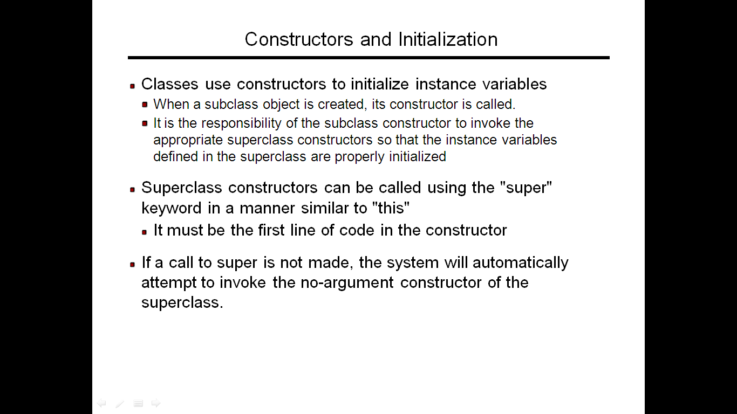

Slide 19
SUPER KEYWORD
To invoke a parent constructor you must place a call to super in the first line of the constructor
You can call a specific parent constructor by the argument that you use in the call to super.
If no this or super call is used in a constructor then the compiler adds an implicit call to super() which calls the parent default constructor

Slide 20
class main extends b
{
public main()
{
super(5);
System.out.println("main");
}
public void callsuper()
{
super.abc();
}
public static void main(String args[])
{
main obj=new main();
obj.callsuper();
}
}

Slide 21
}
class b extends c
{
public b(int x)
{
System.out.println(x);
}
}
class c
{
public c()
{
System.out.println("c");
}
public void abc()
{
System.out.println("message from abc method");
}
}

Slide 22
STATIC MEMBER
Only one copy exist for the entire class
Static methods and block may access only static data member.
Static methods and blocks can call always static methods
They cannot refer to this or super in anyway
This and super are non static member. They cannot be used in main class

Slide 23
If the function is declared static then only one copy of that function exist for many no. of objects

Slide 24
class staticex
{
static int count=0;
public staticex()
{
count=count+1;
}
public static void main(String args[])
{
new staticex();
new staticex();
new staticex();
System.out.println(count);
}
}

Slide 25
ABSTRACT CLASS
A class that declares the existence of method but not the implementation is called an abstract class
You can declare a class as abstract by marking it with abstract keyword
An abstract class can contain member variable and non abstract methods also

Slide 26
Object of abstract class cannot be declared. it can only be inherited
Wherever abstract class is inherited it is necessary to declare body of a function in the inherited class

Slide 27
Access specifiers
Private:
can be accessed only within the
declaring class
Protected :
can be accesed in the declaring class as well as derived class, and all other class in the same package

Slide 28
Public:
global scope. Can be used in any package or class

